Slide 1
Introduction to Computer Science and Programming
Labo 13 – C++ Multi Dimensional Arrays, Structs
Laboratory 13, March 12, 2026
Filippo Ricca – Muhammad Mohsin
DIBRIS, University of Genova

Slide 2
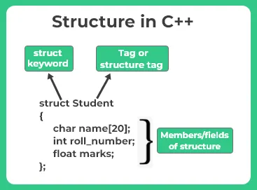
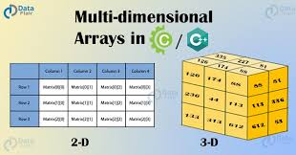
Today…
Today's lab is dedicated to Multi Dimensional Arrays and Structs
Exercise 1: 2D Array Statistics
Exercise 2: 2D Multiplication
Exercise 3: Rectangle Containment Check Using Structs
Exercise 4: Student Record System
Exercise 5: Inventory Management System
All the C++ program must be delivered on Aulaweb!
Notes:
Today we will do some simple exercises on using the computer

Slide 3
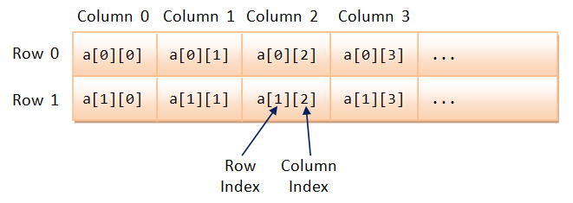
Multi dimensional Arrays
A multi-dimensional array is an array with more than one dimension. It means that it can grow in different directions i.e. instead of changing the length only, it can also change in width, depth or more.
In C++ you can define multidimensional arrays with any number of dimensions. The most common multidimensional array type is the two-dimensional array, so called matrix.

Slide 4
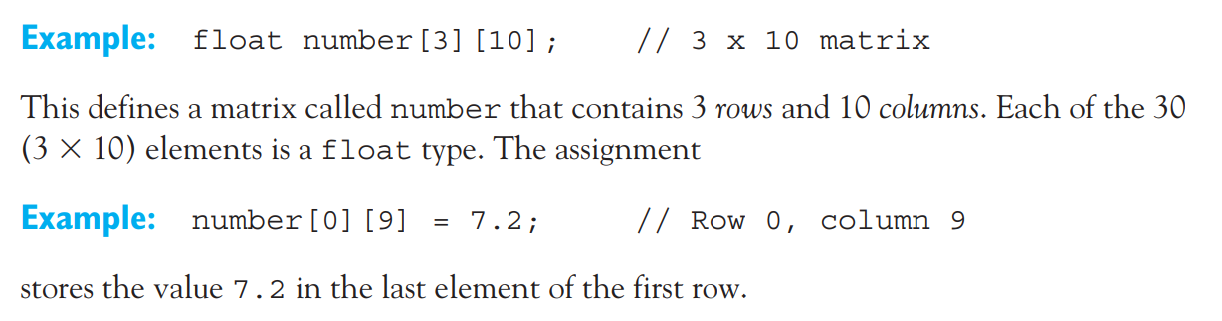

Slide 5

Exercise 1: 2D Array Statistics
You are required to write a C++ program that performs the following tasks:
Input a 2D matrix from the user. The matrix will be of fixed size 5 rows × 4 columns of integers.
Print the matrix in a neat, readable grid format.
Compute the sum of each row individually and display it.
Find the maximum value across the entire matrix.
Function | Description
void fillMatrix(int m[][4], int rows) | Fills the matrix with values entered by the user via cin
void printMatrix(int m[][4], int rows) | Prints the matrix in a neat grid using cout
int rowSum(int m[][4], int cols, int row) | Returns the sum of a specific row (given by index)
int findMax(int m[][4], int rows, int cols) | Returns the maximum value in the entire matrix, use sizeof inside this function to compute the number of columns dynamically
Notes:
#include <iostream>
using namespace std;
// Function to fill the matrix
void fillMatrix(int m[][4], int rows)
{
int cols = sizeof(m[0]) / sizeof(m[0][0]);
cout << "Enter matrix elements:\n";
for(int i = 0; i < rows; i++)
{
for(int j = 0; j < cols; j++)
{
cin >> m[i][j];
}
}
}
// Function to print the matrix
void printMatrix(int m[][4], int rows)
{
int cols = sizeof(m[0]) / sizeof(m[0][0]);
cout << "\nMatrix:\n";
for(int i = 0; i < rows; i++)
{
for(int j = 0; j < cols; j++)
{
cout << m[i][j] << "\t";
}
cout << endl;
}
}
// Function to compute the sum of a specific row
int rowSum(int m[][4], int cols, int row)
{
int sum = 0;
for(int j = 0; j < cols; j++)
{
sum += m[row][j];
}
return sum;
}
// Function to find the maximum value in the matrix
int findMax(int m[][4], int rows, int cols)
{
int maxVal = m[0][0];
for(int i = 0; i < rows; i++)
{
for(int j = 0; j < cols; j++)
{
if(m[i][j] > maxVal)
{
maxVal = m[i][j];
}
}
}
return maxVal;
}
int main()
{
int rows = 3;
int cols = 4;
int matrix[3][4];
// Fill the matrix
fillMatrix(matrix, rows);
// Print the matrix
printMatrix(matrix, rows);
// Compute row sums
cout << "\nRow sums:\n";
for(int i = 0; i < rows; i++)
{
cout << "Sum of row " << i << " = " << rowSum(matrix, cols, i) << endl;
}
// Find maximum value
cout << "\nMaximum value in the matrix = " << findMax(matrix, rows, cols) << endl;
return 0;
}

Slide 6
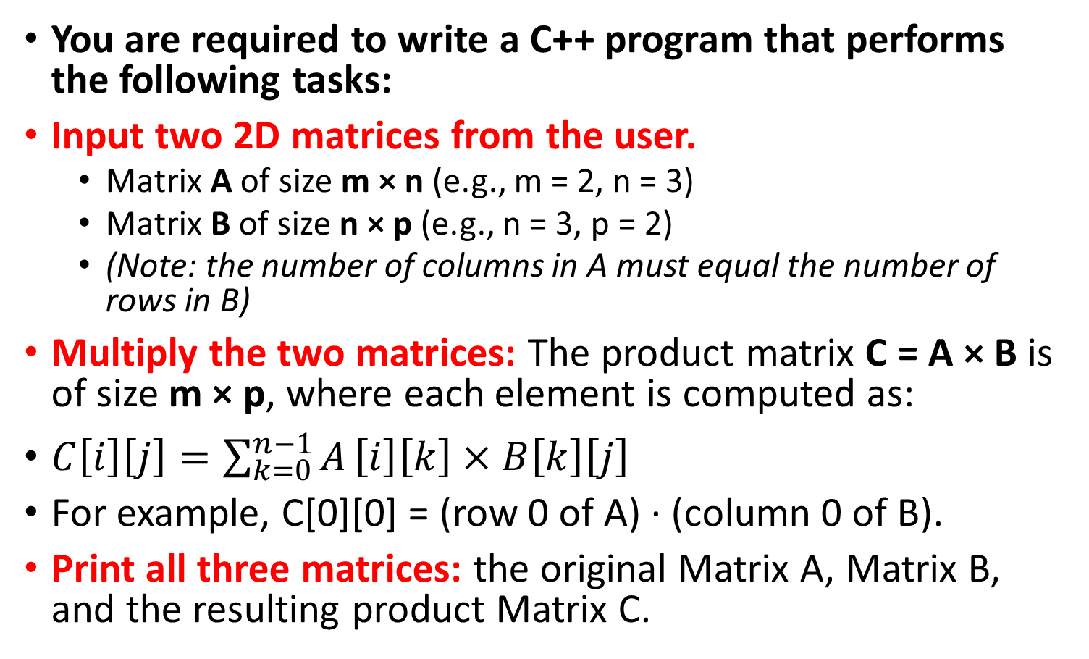
Exercise 2: 2D Multiplication
You are required to write a C++ program that performs the following tasks:
Input two 2D matrices from the user.
Matrix A of size m × n (e.g., m = 2, n = 3)
Matrix B of size n × p (e.g., n = 3, p = 2)
(Note: the number of columns in A must equal the number of rows in B)
Multiply the two matrices: The product matrix C = A × B is of size m × p, where each element is computed as:
$C\left[i\right]\left[j\right]=\sum_{k=0}^{n−1}{A}\left[i\right]\left[k\right]×B\left[k\right]\left[j\right]$
For example, C[0][0] = (row 0 of A) · (column 0 of B).
Print all three matrices: the original Matrix A, Matrix B, and the resulting product Matrix C.

Slide 7
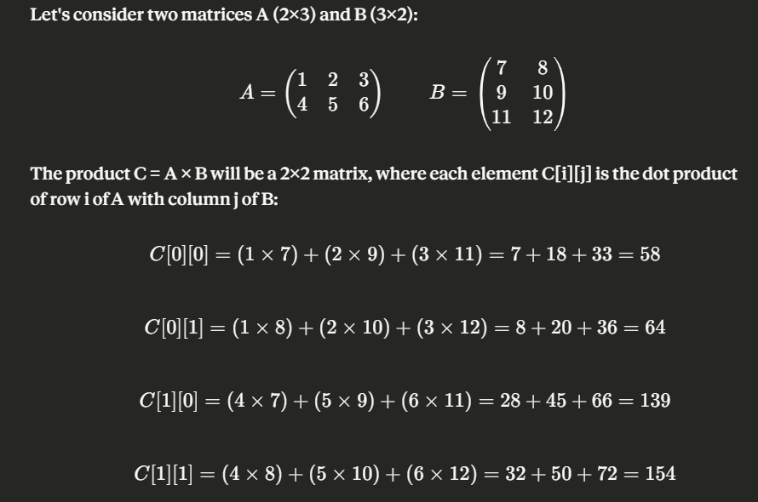
Always remember: Matrix multiplication is only possible when the number of columns in A equals the number of rows in B

Slide 8
Struct
A struct is heterogeneous in that it can be composed of data of different types

Slide 9
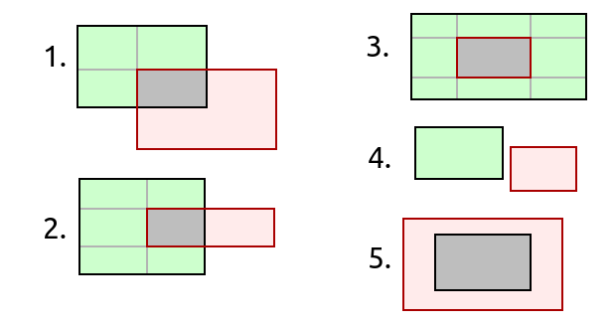
Exercise 3: Rectangle Containment Check Using Structs
Define a struct Rect to represent a rectangle using its vertices (Point) at the top-left and bottom-right
Write a C++ program that reads two rectangles as input, asking for the coordinates of the top_left and bottom_right points of each
Check if one of the two rectangles is contained within the other and print an appropriate output message
Notes:
#include <iostream>
struct Point {
int x, y;
};
struct Rect {
Point top_left;
Point bottom_right;
};
// Function to check if rect1 is contained within rect2
bool isContained(const Rect& rect1, const Rect& rect2) {
return (rect1.top_left.x >= rect2.top_left.x &&
rect1.top_left.y <= rect2.top_left.y &&
rect1.bottom_right.x <= rect2.bottom_right.x &&
rect1.bottom_right.y >= rect2.bottom_right.y);
}
int main() {
Rect rect1, rect2;
// Input for first rectangle
std::cout << "Enter the coordinates of the first rectangle (top_left x y, bottom_right x y): ";
std::cin >> rect1.top_left.x >> rect1.top_left.y >> rect1.bottom_right.x >> rect1.bottom_right.y;
// Input for second rectangle
std::cout << "Enter the coordinates of the second rectangle (top_left x y, bottom_right x y): ";
std::cin >> rect2.top_left.x >> rect2.top_left.y >> rect2.bottom_right.x >> rect2.bottom_right.y;
// Check if one rectangle is contained within the other
if (isContained(rect1, rect2)) {
std::cout << "The first rectangle is contained within the second rectangle.\n";
} else if (isContained(rect2, rect1)) {
std::cout << "The second rectangle is contained within the first rectangle.\n";
} else {
std::cout << "Neither rectangle is fully contained within the other.\n";
}
return 0;
}

Slide 10
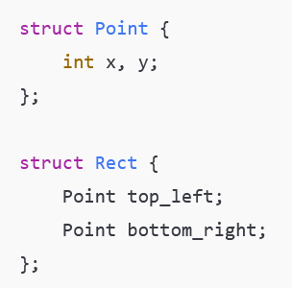
Structs and Algo idea
xT1, yT1
xT2, yT2
xB2, yB2
xB1, yB1
You have to check:
xT2>xT1 and yT1>yT2 and xB2<xB1 andyB2>yB1

Slide 11
Exercise 4: Student Record System
You are required to write a C++ program that performs the following tasks:
Define a struct to represent a student record containing:
string name the student's full name
int id the student's ID number
float grades[4] an array of four grades
Compute the average grade of a student using a dedicated function.
Print a student's full record, including their name, ID, all four grades, and their computed average.
Display the honor roll print only the students whose average exceeds a given threshold.
Notes:
#include <iostream>
#include <string>
using namespace std;
// Define the struct
struct Student {
string name;
int id;
float grades[4];
};
// Function to compute average grade
float computeAverage(Student s) {
float sum = 0;
for(int i = 0; i < 4; i++) {
sum += s.grades[i];
}
return sum / 4;
}
// Function to print a student's full record
void printStudent(Student s) {
cout << "Name: " << s.name << endl;
cout << "ID: " << s.id << endl;
cout << "Grades: ";
for(int i = 0; i < 4; i++) {
cout << s.grades[i] << " ";
}
cout << endl;
cout << "Average: " << computeAverage(s) << endl;
cout << "---------------------" << endl;
}
// Function to display honor roll students
void honorRoll(Student students[], int n, float threshold) {
cout << "\nHonor Roll Students:\n";
for(int i = 0; i < n; i++) {
if(computeAverage(students[i]) > threshold) {
printStudent(students[i]);
}
}
}
int main() {
int n;
cout << "Enter number of students: ";
cin >> n;
Student students[n];
// Input student data
for(int i = 0; i < n; i++) {
cout << "\nEnter name: ";
cin.ignore();
getline(cin, students[i].name);
cout << "Enter ID: ";
cin >> students[i].id;
cout << "Enter 4 grades: ";
for(int j = 0; j < 4; j++) {
cin >> students[i].grades[j];
}
}
// Print all student records
cout << "\nAll Student Records\n";
cout << "====================\n";
for(int i = 0; i < n; i++) {
printStudent(students[i]);
}
// Honor roll
float threshold;
cout << "\nEnter honor roll threshold: ";
cin >> threshold;
honorRoll(students, n, threshold);
return 0;
}

Slide 12
Exercise 5: Inventory Management System
You are required to write a C++ program that performs the following tasks:
Define a struct to represent a product containing:
string name: product name
int id: product ID
int quantity: stock quantity
float price: price per unit
Compute the total stock value of a single product (quantity × price).
Apply a discount to all products whose stock value exceeds a given threshold.
Find the most valuable product (highest total stock value).
Display a low stock warning for any product with quantity below a given limit.
Notes:
#include <iostream>
#include <string>
using namespace std;
// Define struct
struct Product {
string name;
int id;
int quantity;
float price;
};
// Function to compute total stock value
float stockValue(Product p) {
return p.quantity * p.price;
}
// Apply discount if stock value exceeds threshold
void applyDiscount(Product products[], int n, float threshold, float discountRate) {
for(int i = 0; i < n; i++) {
if(stockValue(products[i]) > threshold) {
products[i].price *= (1 - discountRate);
}
}
}
// Find most valuable product
int mostValuable(Product products[], int n) {
int index = 0;
float maxValue = stockValue(products[0]);
for(int i = 1; i < n; i++) {
if(stockValue(products[i]) > maxValue) {
maxValue = stockValue(products[i]);
index = i;
}
}
return index;
}
// Display low stock warning
void lowStockWarning(Product products[], int n, int limit) {
cout << "\nLow Stock Products:\n";
for(int i = 0; i < n; i++) {
if(products[i].quantity < limit) {
cout << products[i].name << " (ID: " << products[i].id << ") has low stock.\n";
}
}
}
// Print product details
void printProduct(Product p) {
cout << "Name: " << p.name << endl;
cout << "ID: " << p.id << endl;
cout << "Quantity: " << p.quantity << endl;
cout << "Price: " << p.price << endl;
cout << "Stock Value: " << stockValue(p) << endl;
cout << "-----------------------\n";
}
int main() {
int n;
cout << "Enter number of products: ";
cin >> n;
Product products[n];
// Input products
for(int i = 0; i < n; i++) {
cout << "\nEnter product name: ";
cin >> products[i].name;
cout << "Enter ID: ";
cin >> products[i].id;
cout << "Enter quantity: ";
cin >> products[i].quantity;
cout << "Enter price: ";
cin >> products[i].price;
}
float threshold, discount;
cout << "\nEnter stock value threshold for discount: ";
cin >> threshold;
cout << "Enter discount rate (e.g., 0.1 for 10%): ";
cin >> discount;
applyDiscount(products, n, threshold, discount);
cout << "\nAll Products:\n";
for(int i = 0; i < n; i++) {
printProduct(products[i]);
}
int index = mostValuable(products, n);
cout << "\nMost Valuable Product:\n";
printProduct(products[index]);
int limit;
cout << "\nEnter low stock limit: ";
cin >> limit;
lowStockWarning(products, n, limit);
return 0;
}

